Slide 1

HR Insights and Analysis
Team 3

Slide 2

A Detailed Review of Department Performance, Employee Retention, and Diversity
The team members
Sara Hossam Elden Mohamed Maya Mohamed Nashy Hagar Ahmed Mohamed Sama Walid mohamed Samer Ehab Saad

Slide 3

Agenda
Overview of the Dashboards
Department Dashboard
Design Concepts
Data Visualization
Insights
Employee Diversity Dashboard
Design Concepts
Data Visualization
Insights
Conclusions and Recommendations

Slide 4
Overview
Department Dashboard
Employee Diversity Dashboard
This dashboard gives us a bird's-eye view of our organizational structure, highlighting manager performance, turnover rates, employee satisfaction, and salary distribution across departments.
This dashboard delves into the composition of our workforce, showcasing metrics on employee loyalty, diversity, hiring trends, and age distribution.
we'll have a comprehensive understanding of our current HR landscape and be equipped with insights to drive positive change.

Slide 5
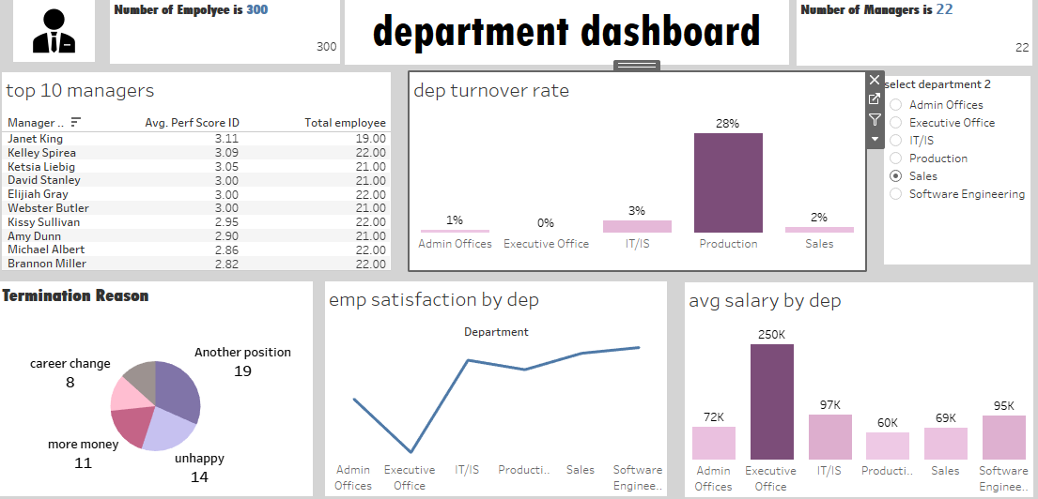
Department Dashboard

Slide 6
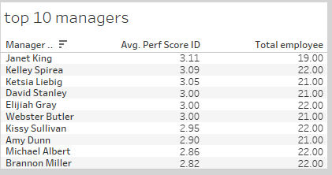
Top 10 Managers
Key observations:
Our top managers consistently score above 3.0, indicating exceptional performance.
There's a mix of team sizes among top performers, suggesting that high performance is possible regardless of team size.
Janet King's ability to maintain the highest score while managing a sizable team is particularly noteworthy.

Slide 7
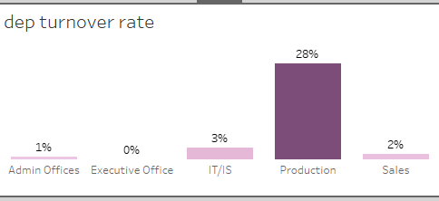
Department Turnover Rate
Key Observations:
1. The Production department's turnover rate is alarmingly high at 28%, significantly outpacing all other departments
2. Sales and IT/IS have relatively low turnover rates, while Executive and Admin offices show minimal turnover.
Implications:
1. The high turnover in Production is likely causing disruptions in workflow, increased training costs, and potential quality issues.
2. There may be underlying issues specific to the Production department, such as work conditions, management style, or compensation, that need immediate attention.
3. The stability in other departments, particularly Executive and Admin offices, suggests that company-wide policies are generally effective in retaining employees.

Slide 8
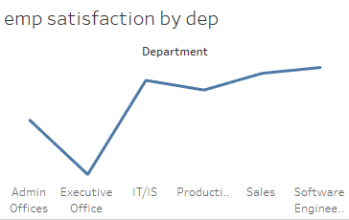
Employee Satisfaction by Department
Key observations:
1.There's a clear correlation between employee satisfaction and turnover rates in most departments.
2.The Executive Office shows the highest satisfaction, which aligns with its 0% turnover rate.
3.IT/IS has the lowest satisfaction, yet maintains a relatively low turnover rate (3%).
4.Production's low satisfaction correlates with its high turnover rate.
5.Sales shows high satisfaction and low turnover, indicating a positive work environment.
Implications:
1.The disconnect between low satisfaction and low turnover in IT/IS suggests other factors (e.g., job market conditions, compensation) may be retaining employees despite dissatisfaction.
2.Production's low satisfaction and high turnover indicate a critical need for improvement in this department.
3.The Executive Office and Sales could serve as models for employee engagement and satisfaction initiatives.

Slide 9
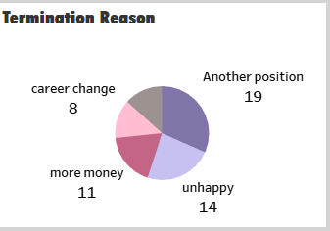
Termination Reasons
Key observations:
1.The top reason for leaving is finding another position, followed closely by general unhappiness.
2.Financial motivations ("more money") are the third most common reason.
3.Career change is a significant factor, though less common than the others.
Implications:
1.Employees leaving for "another position" could indicate issues with career growth opportunities or job satisfaction within our organization.
2.The high number of "unhappy" employees suggests potential problems with work environment, management, or company culture.
3.Financial compensation is a notable factor but not the primary driver of turnover.
4.Some employees are seeking entirely different career paths, which may be harder to address internally.

Slide 10
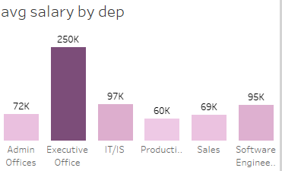
Average Salary by Department
Key observations:
1.There's a substantial gap between the Executive Office and all other departments.
2.IT/IS and Software Engineering have the next highest average salaries, reflecting the tech industry's competitive pay.
3.Production, despite its high turnover rate, has the lowest average salary.
4.Sales salaries are relatively low considering the department's high satisfaction and low turnover rates.
Implications:
1.The low salaries in Production likely contribute to its high turnover and low satisfaction rates.
2.The high Executive Office salaries, while expected, may create perceived inequity within the organization.
3.IT/IS's higher salaries may explain why turnover remains low despite low satisfaction.
4.Sales' combination of high satisfaction and relatively low pay suggests strong non-monetary motivators in this department.

Slide 11
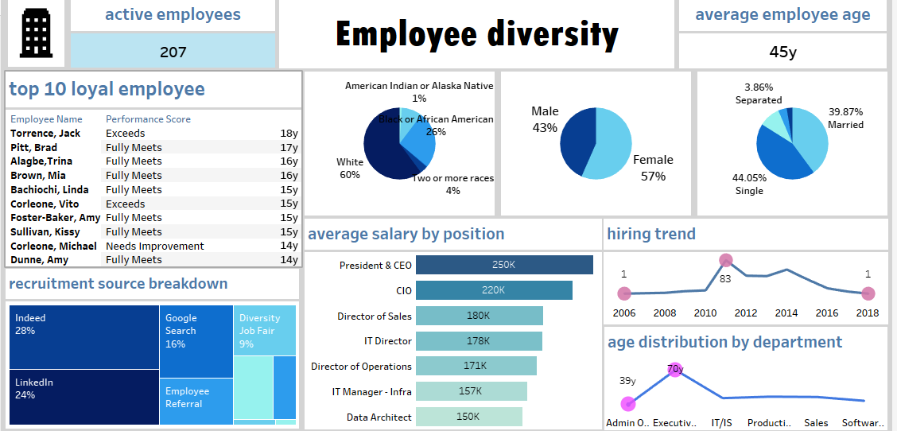
Employee Diversity Dashboard

Slide 12
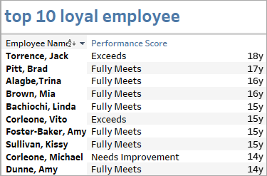
Top 10 Loyal Employees
Key observations:
1.Our top loyal employees have been with the company for 14-18 years, indicating strong retention of long-term staff.
2.Most of these employees are meeting or exceeding performance expectations, showing a positive correlation between loyalty and performance.
3.There's a mix of performance levels, with two employees "Exceeding" expectations, seven "Fully Meeting," and one "Needs Improvement."
Imblications:
1.Long-term employees bring valuable institutional knowledge and stability to the organization.
2.The high performance of most long-term employees suggests that experience within the company translates to effectiveness.
3.The presence of a long-term employee needing improvement (Corleone, Michael) indicates that loyalty alone doesn't guarantee high performance.

Slide 13
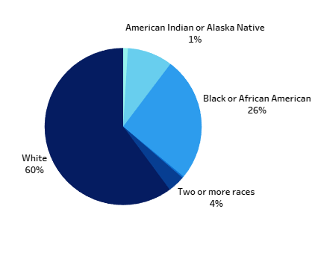
Diversity Metrics - Race
Key observations:
1.Our workforce is predominantly White, making up 60% of our employees.
2.Black or African American employees form a significant minority at 26%.
3.We have a small percentage of multiracial employees and American Indian or Alaska Native representation.
4.There's a notable 9% of employees from other racial backgrounds not specified in the main categories.
Imblications:
1.While we have some diversity, there's room for improvement in representing minority groups.
2.The significant presence of Black or African American employees is a positive sign of inclusivity.
3.The low percentage of multiracial and American Indian or Alaska Native employees suggests potential areas for focused diversity initiatives.
4.The 9% "other" category indicates a need for more granular data collection to understand our full diversity spectrum.

Slide 14
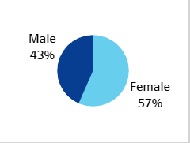
Diversity Metrics - Gender
Key observations:
1.We have a slightly higher proportion of female employees, which is positive for gender diversity.
2.The gender split is relatively balanced, with a difference of 14 percentage points.
Imblications:
1.Our organization is doing well in terms of overall gender representation, bucking the trend in many industries where male employees often outnumber female employees.
2.This balance suggests that our hiring practices and work environment may be appealing to both genders.
3.While the overall numbers are positive, we need to examine gender distribution across different levels and departments to ensure equal opportunities.

Slide 15
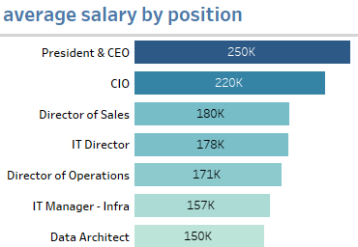
Average Salary by Position
Key observations:
1.There's a clear hierarchical structure in our pay scale, with C-suite executives at the top.
2.The President & CEO's salary is significantly higher than other positions, creating a large gap.
3.IT and technical roles (CIO, IT Director, IT Manager - Infra, Data Architect) command high salaries, reflecting the value of technical skills.
4.Sales leadership (Director of Sales) is also well-compensated, indicating the importance of revenue generation.
Imblications:
1.The salary structure aligns with typical corporate hierarchies, which can provide clear career progression paths.
2.The high salaries for IT roles suggest we're competing for top talent in the tech industry.
3.The significant gap between the CEO's salary and other positions may impact employee perceptions of equity.
4.The emphasis on sales compensation aligns with the department's high satisfaction and low turnover rates.

Slide 16
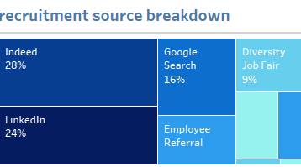
Recruitment Source Breakdown
Key Observations:
1.Online job platforms (Indeed and LinkedIn) are our primary sources of new hires, accounting for 52% of our recruitment.
2.Employee referrals are a significant source, contributing nearly a quarter of our new hires.
3.Google Search plays a notable role, suggesting the importance of our online presence and SEO strategies.
4.Diversity Job Fair, while the smallest category, represents a dedicated effort to increase workplace diversity.
Imblications:
1.Our reliance on online platforms aligns with modern recruitment trends but may limit our reach to passive job seekers.
2.The strong performance of employee referrals suggests we have engaged employees willing to recommend our company.
3.The success of Google Search in bringing candidates indicates that potential employees are actively seeking us out.
4.While Diversity Job Fair has the lowest percentage, it's a crucial channel for meeting our diversity goals.

Slide 17
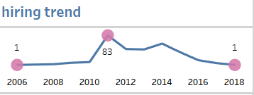
Hiring Trends
Key observations:
1.There was a massive spike in hiring in 2010, with 83 new employees brought on board.
2.After 2010, hiring rates have consistently decreased, reaching just 1 hire in 2018.
3.There are gaps in the data for 2008 and 2012, which could indicate either no hires or missing information.
Imblications:
1.The 2010 spike likely represents a period of significant company growth or expansion.
2.The consistent decrease in hiring since 2010 could indicate:
a) A shift towards stability after rapid growth
b) Budget constraints or cost-cutting measures
c) Improved retention reducing the need for new hires
d) Potential stagnation or contraction of the business
3.The very low hiring rate in recent years (2016-2018) may lead to an aging workforce and potential skill gaps.

Slide 18
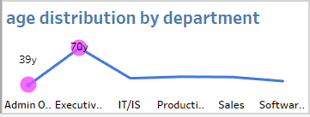
Age Distribution by Department
Key observations:
1.The Executive Office has a significantly higher average age (70 years) compared to all other departments.
2.Most departments (IT/IS, Production, Sales, Software Engineering) have a consistent average age of around 40-41 years.
3.The Admin Offices have the youngest average age at 39 years, though only slightly younger than other departments.
Imblications:
1.The high average age in the Executive Office suggests a very experienced leadership team but also indicates a pressing need for succession planning.
2.The consistency across most departments indicates a mature workforce with significant experience.
3.The relatively high average ages across all departments suggest we may face challenges in attracting and retaining younger talent.
4.We may be at risk of losing a significant portion of our workforce to retirement in the coming years, especially in the Executive Office.

Slide 19
Conclusion and Recommendations
Recommendations:
1. Address Production Department Issues:
- Conduct in-depth surveys and exit interviews to identify root causes of high turnover. - Review compensation and working conditions in this department. - Implement targeted retention strategies.
2. Enhance Employee Satisfaction:
- Develop department-specific engagement programs. - Address salary disparities, especially in lower-paid departments. - Expand career development opportunities across all levels.
3. Strengthen Diversity and Inclusion:
- Set specific goals for increasing representation of underrepresented minorities. - Implement unconscious bias training for all employees. - Create employee resource groups to support diverse employees.
4. Prepare for Workforce Aging:
- Develop a comprehensive succession planning strategy, especially for the Executive Office. - Implement knowledge transfer and mentorship programs. - Review recruitment strategies to attract younger talent.
5. Optimize Recruitment Strategies:
- Enhance our employee referral program. - Increase participation in diversity job fairs. - Invest in our online presence and employer branding.
6. Improve Data Collection and Analysis:
- Ensure consistent tracking of hiring data. - Expand diversity metrics to capture more detailed information. - Regularly benchmark our metrics against industry standards.

Slide 20



THANK YOU!

